Slide 1

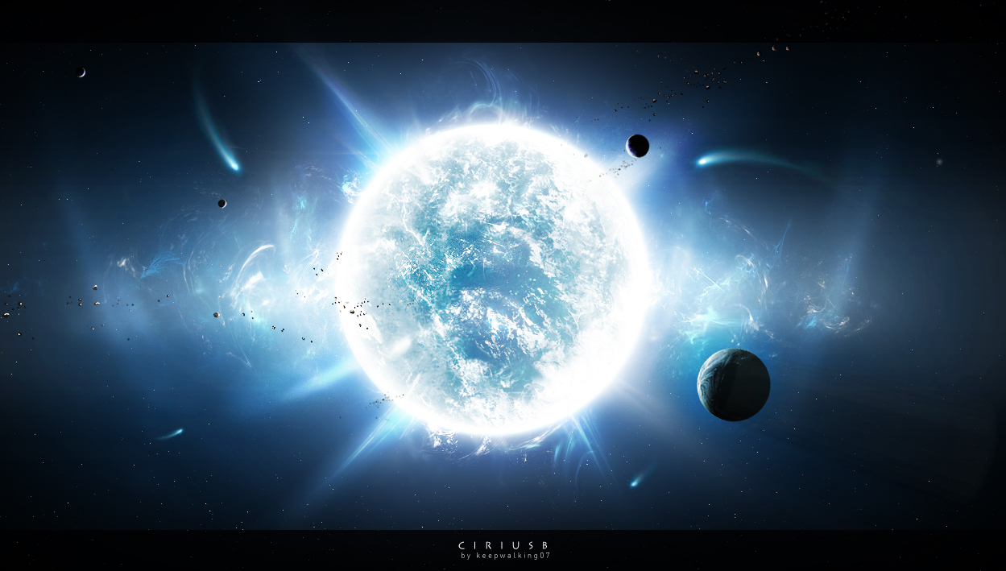
Discovering
Stellar
Secrets

Slide 2
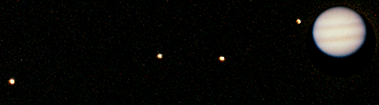
Jupiter Through the Telescope
You can see 2-3 bands of dark and light clouds on the face of Jupiter.
Up to four of Jupiter's largest moons may appear as pearls strung on either side of the planet.

Slide 3
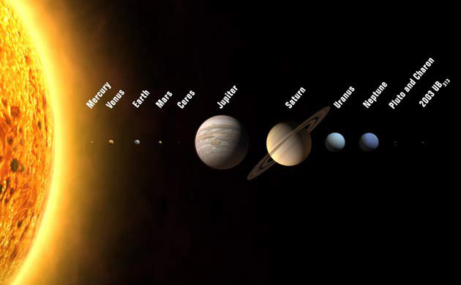
Jupiter
Jupiter is the 5th planet from the sun and the largest planet in our solar system made almost entirely of hydrogen and helium gas.

Slide 4
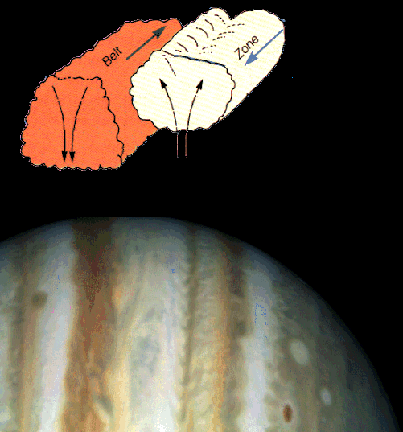
Jupiter’s Atmosphere
The stripes are called belts and zones
The white zones are high clouds of white ammonia ice crystals. The darker belts are lower clouds of ammonium hydrosulfide.
Powerful winds blow along each belt and zone, sweeping the clouds in opposite directions.

Slide 5
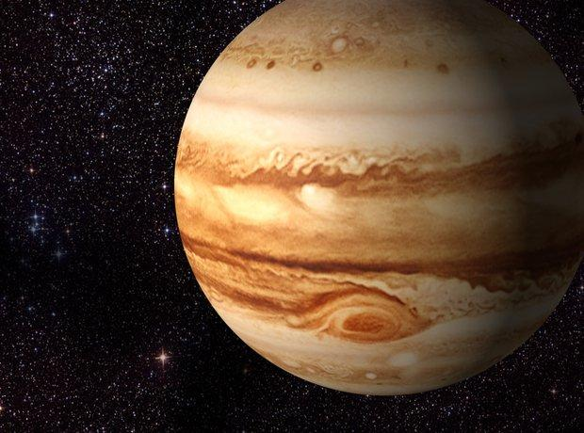
Jupiter - a Failed Star?
Jupiter is made of the same material as our Sun. If Jupiter had 100 times more material (hydrogen and helium), it would have become a star.

Slide 6
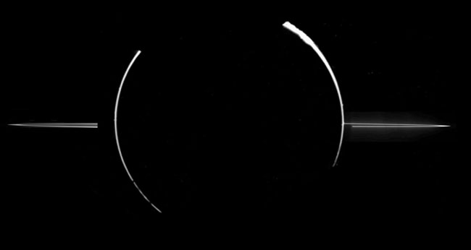

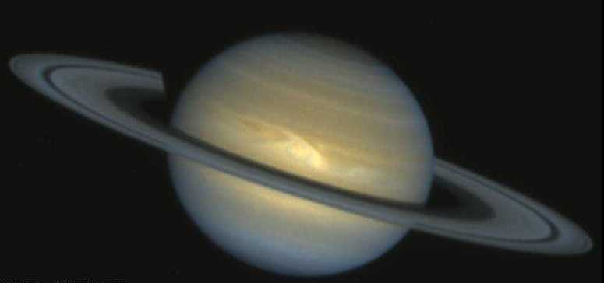

Jupiter’s Rings
Although Jupiter’s ring system is much less visible than the bold rings of Saturn…
Jupiter’s rings
20-200 mi. thick
Jupiter’s rings are actually many times thicker from top to bottom.
Saturn’s rings
33 – 650 ft. thick

Slide 7
Jupiter’s Rings
Jupiter’s ring systems are composed of tiny dust-sized particles created from meteor collisions with its four small inner moons…
Saturn’s rings are made up primarily of chunks of ice and rock and is gravitationally flattened into a much thinner feature.

Slide 8
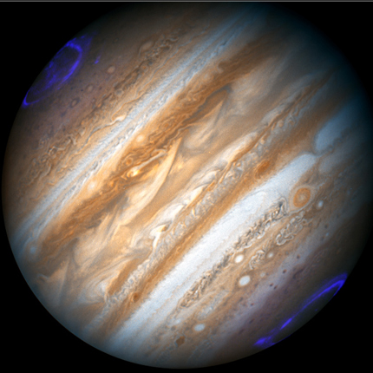
Jupiter’s Aurora
The aurora at Jupiter’s poles appears to be caused by material from Io’s volcanoes spiraling into Jupiter’s atmosphere along its magnet field lines.

Slide 9
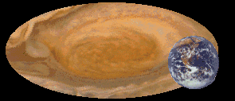
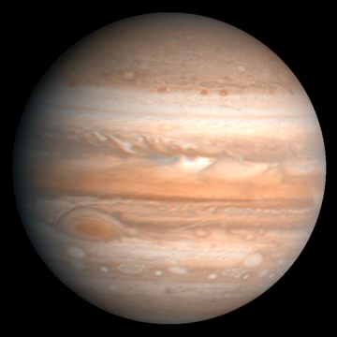
The Great Red Spot
Jupiter's Great Red Spot is a vast rotating storm that has existed for over 300 years. It is two to three times the size of Earth.

Slide 10
The Great Red Spot
The winds in the Great Red Spot rotate counter-clockwise.
It takes 4 to 6 days for the outer edge of the Spot to rotate.
Smaller spots interact with it and each other too.

Slide 11
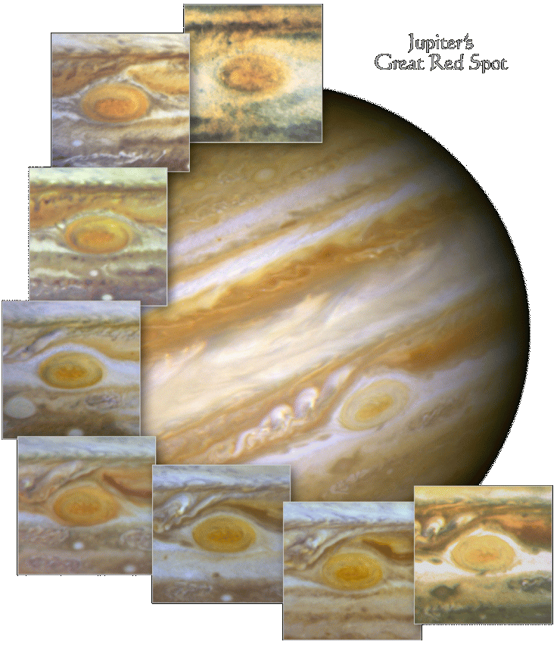
Changes in Jupiter’s Great Red Spot
1992-1999
We know the storm is a high-pressure system, with winds up to 270 mph.
Hubble has been used to monitor the Great Red Spot to see how the storm is changing over time.

Slide 12
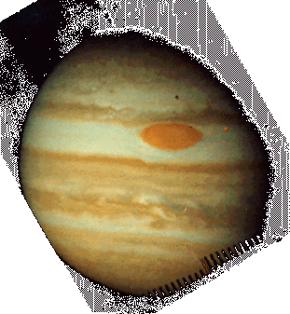
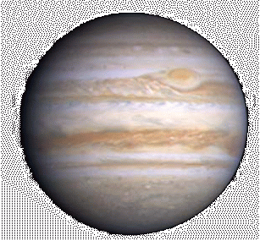
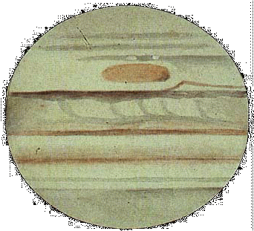
The Incredible Shrinking Red Spot?
1881 Drawing
1973 Photo
2000 Photo
The Great Red Spot is only about half as big as it was in the 1880s when it was more than three times Earth's diameter. By 1979, when Voyager flew by, it was only 2 Earths across.
No one knows why the Spot has shrunk or why its color has faded. One clue is that the winds around it are whirling 70 percent faster now than they were in the Voyager era.

Slide 13
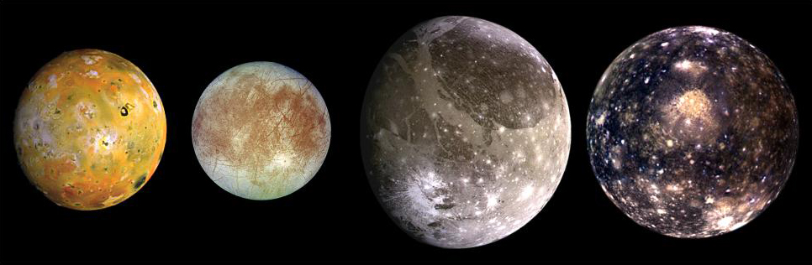
Jupiter’s Galilean Moons
Europa
Io
Callisto
Ganymede
Geologically Active
Geologically Inactive
Of Jupiter’s 63 moons, four of them, called the Galilean moons, are large enough for us to see with our telescope.
Voyager 1 and 2 found a lot of very interesting things about Jupiter’s moons when it visited 35 years ago …

Slide 14
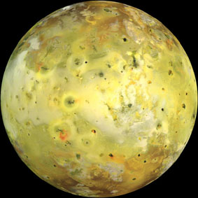
Galilean Moons - Io
Io, the closest Galilean moon to Jupiter, was found to have active volcanoes on its surface.
The volcanoes constantly resurface the moon erasing any evidence of impact craters.

Slide 15
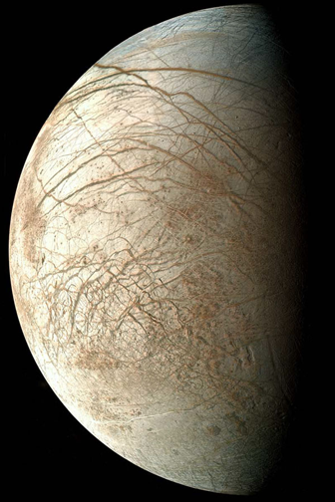
Galilean Moons - Europa
Europa is the smoothest of all solid planets and moons in our solar system. It is covered by a thin, 3 mile thick crust of water ice with cracks and ridges, but almost no remaining impact craters.
It is believed that a 30 mile deep water ocean lies beneath the ice.

Slide 16
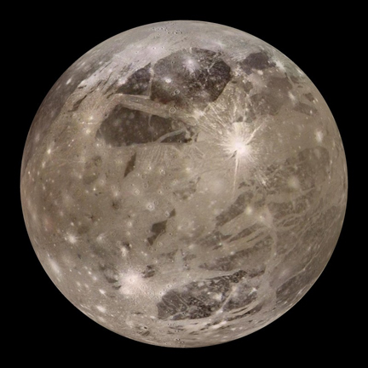
Galilean Moons - Ganymede
Ganymede is the largest moon in our solar system at 3,280 miles wide – larger than Mercury.
It is both cratered and grooved implying a water-ice crust under tension from global tectonics.

Slide 17
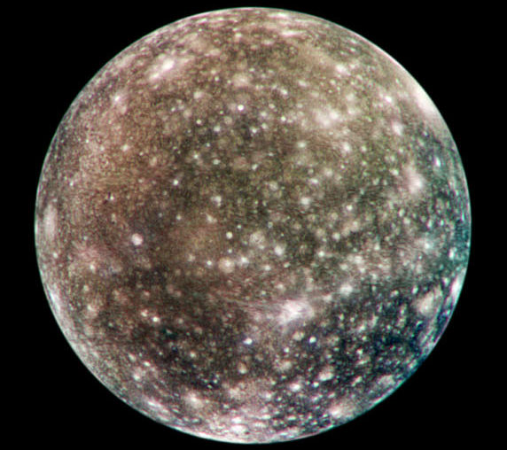
Galilean Moons - Callisto
Callisto is the same size as Mercury, made of rock and ice in equal parts.
It has the most heavily cratered surface of any moon in the solar system. This may be because it is geologically inactive and located near a huge gravity well - Jupiter.

